Slide 1
Lecture 3: Spam Filtering
Siddharth Garg
sg175@nyu.edu

Slide 2
Spam Detection: Features
Recall features used in the UCI Spam database
Even easier way to encode features:
x_{i} = 1 if term i appears in a document; 0 otherwise
Boolean features
Assume M Boolean features, x = (x₁, x₂,…, x_{M})
We want to map this M-dimensional Boolean input to a Boolean output y
Thoughts?
Instead of using LR or SVM we will start with an even simpler approach referred to as “Naiive Bayes”
Ref: Metsis, Vangelis, Ion Androutsopoulos, and Georgios Paliouras. "Spam filtering with naive bayes-which naive bayes?." In CEAS, vol. 17, pp. 28-69. 2006.

Slide 3
Naiive Bayes for Spam Filtering
Assume M Boolean feature, x = (x_{1,}x₂,…, x_{M})
Each email is either {s=spam,l=legit}
We begin by computing:
“Bernoulli Naiive Bayes”
Bayes Rule
Ref: Metsis, Vangelis, Ion Androutsopoulos, and Georgios Paliouras. "Spam filtering with naive bayes-which naive bayes?." In CEAS, vol. 17, pp. 28-69. 2006.

Slide 4
Naiive Bayes for Spam Filtering
We begin by computing:
Assuming that term occurrences are independent (given class)!
Is this a reasonable assumption?

Slide 5
Naiive Bayes for Spam Filtering
How do we estimate this from the training dataset?
=(#Spam emails that contain term 1)/(#spam emails)
What happens if term 1 never occurred in any spam email in the training dataset?

Slide 6
Laplacian Smoothing
(#Spam emails that contain term 1)/(#spam emails)
= (#Spam emails that contain term 1+1)/(#spam emails+2)
Equivalent to assuming two addition spam emails in the training dataset, of which on contains all terms and the other is empty

Slide 7
Naiive Bayes for Spam Filtering
Vs.
Or:

Slide 8
In-Class Exercise
# Spam Emails in Training Dataset: 50
# Legit Emails in Training Dataset: 100
Word/Term | #Spam Emails with Term | #Legit Emails with Term
“FREE” | 40 | 0
“George” | 0 | 20
“and” | 40 | 80
Test Email: {x_{FREE}, x_{GEORGE}, x_{and}} = {1,1,0}
Vs.

Slide 9
Solution
# Spam Emails in Training Dataset: 50
# Legit Emails in Training Dataset: 100
Word/Term | #Spam Emails with Term | #Legit Emails with Term
“FREE” | 40 | 0
“George” | 0 | 20
“and” | 40 | 80
Test Email: {x_{FREE}, x_{GEORGE}, x_{and}} = {1,1,0}
Vs.

Slide 10
Spam Detection: Occurences
Recall features used in the UCI Spam database
Let’s consider a different representation that is closer to the UCI spambase features: Term Frequencies (TF)
x_{i} # times term i appears in a document ( )
Each document is represented by x = (x₁, x₂, …, x_{M}), a vector of term frequencies
We will again use a Naïve Bayes approach to classify documents as either spam or legit
“Multinomial Naïve Bayes”

Slide 11
Applying Bayes Rule
Independence assumption shows up again!
But how do we estimate the probability :
What if there is no document in the training dataset where term 1 occurs t times?

Slide 12
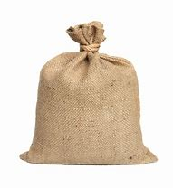
“Bag of Words” Model
Bag containing M terms
wishes
and
george
hello
Term i picked with probability
pills
free
Term i picked with probability
Term i picked with probability
1
2
D
Spam Email Containing D terms/words

Slide 13
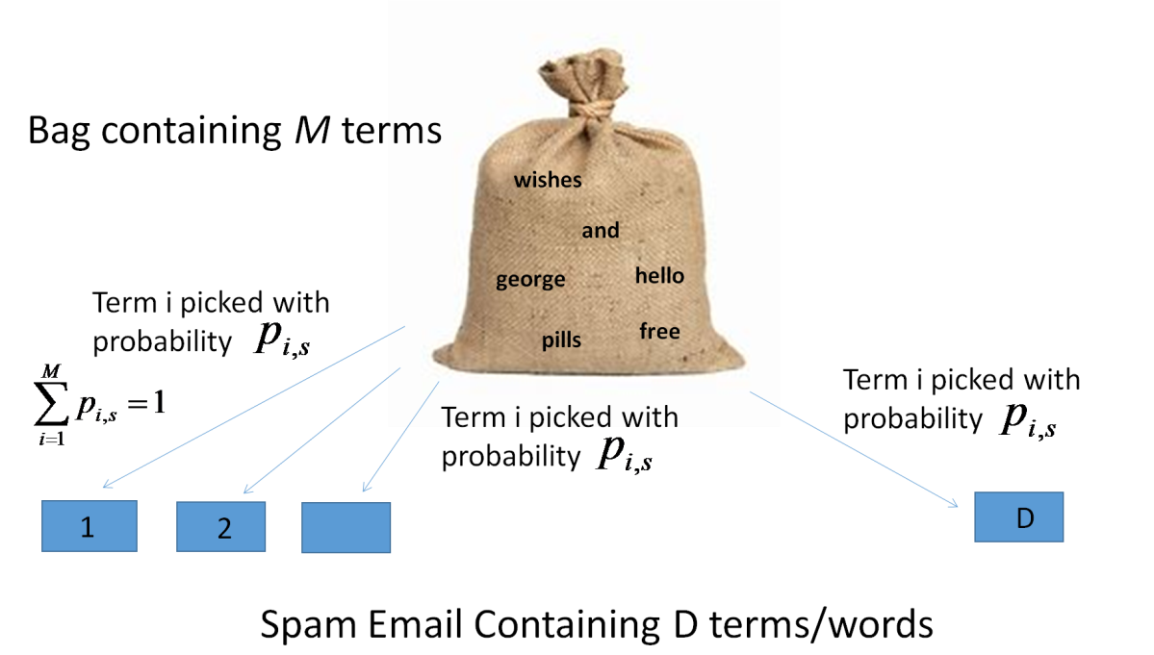
Likelihood Estimation
Say you have a spam e-mail of length D generated using the BoW model
Assuming term and positional independence
Feature vector x
Are we done?

Slide 14
Likelihood Estimation
Recall that the BoW model does not keep track of the positions in which terms appear
We must account for all possible ways of arranging
x₁ instances of term 1 and
x₂ instances of term 2 and
… x_{M} instances of term M into D locations
Choose x₁ locations from a total of D locations
Choose x₂ locations from remaining D- x₁ locations

Slide 15
Likelihood Estimation
Note that this expression is conditioned on the length of the e-mail D. In practice, emails can be of varying lengths.
Typo: this should be x_{i}

Slide 16
Accounting for Document Length
Assume email length is independent of whether email is spam or legit.
Putting it all together:
Vs.

Slide 17
Estimating Model Parameters
Note: this is not the probability of term i appearing in a spam document
Probability that a randomly selected word in a spam email is term i
# occurrences of term i in spam
# occurrences of term i in spam
1+ # occurrences of term i in spam
M+
# occurrences of term i in spam
With Laplacian smoothing

Slide 18
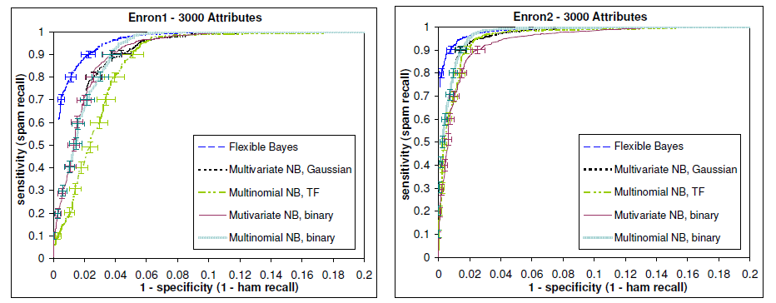
Bernoulli NB Vs. Multinomial NB with TF
Data for 6 different users from ENRON dataset
Augmented with spam emails from various sources (legit = “ham”)
Top-3000 features selected (we will discuss feature selection soon)
% of spam emails predicted as spam
% of legit emails classified as spam

Slide 19
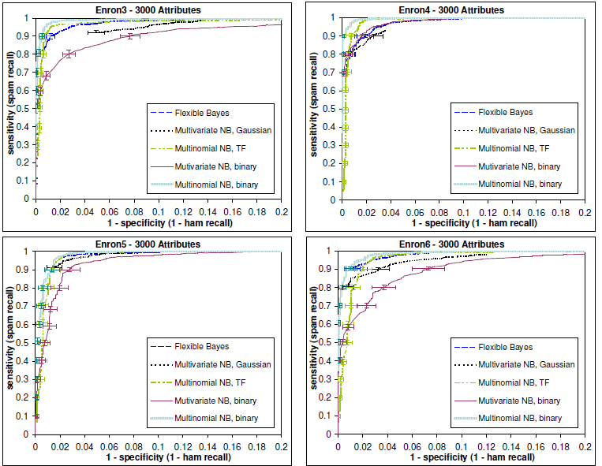
Bernoulli NB Vs. Multinomial NB with TF
Tempted to conclude that using term frequencies instead of binary occurrences helped in spam filtering.
Is there any other reason multinomial NB with TF might have outperformed Bernoulli NB?
% of spam emails predicted as spam
% of legit emails classified as spam

Slide 20
Bernoulli NB Vs. Multinomial NB with TF
Multinomial NB with Binary instead of TF features performs the best!
% of spam emails predicted as spam
% of legit emails classified as spam

Slide 21
Multinomial NB with Binary Features
Let x = (x₁, x₂, …, x_{M}) be the TF features. Binary features are derived from the TF features as follows:
Transformation is applied to both the training and test data and the multinomial model is used for prediction, i.e.,
if
if

Slide 22
Multinomial Vs. Bernoulli NB
Multinomial
Bernoulli
How are the two different?
Multinomial model ignores negative evidence
p_{i,s} is estimated differently
1+ # occurrences of term i in spam
1+ #Spam emails that contain term i
2+#spam emails
M+
# occurrences of term i in spam

Slide 23
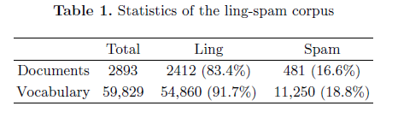
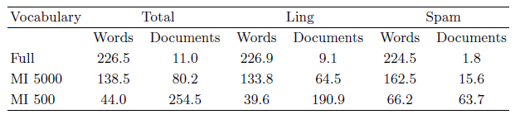
Why Ignore Negative Evidence?
Schneider, Karl-Michael. "On word frequency information and negative evidence in Naive Bayes text classification." Advances in Natural Language Processing. Springer, Berlin, Heidelberg, 2004. 474-485.
Observation 1: >80% of words never occur in spam documents, while only 10% of words never occur in legit documents
Observation 2: On average, documents only contain a very small fraction of words from the vocabulary
For Bernoulli NB, probability of a document is mostly determined by words that do not appear in the document!

Slide 24
Why is Multinomial Binary Features better than Term Frequencies?
Multinomial TF assumes repeated instances of the same word occur independently, but that is not the case -> for example, if a word appears once it is more likely to appear multiple times. Therefore multinomial TF is a poor model for the underlying data.

Slide 25
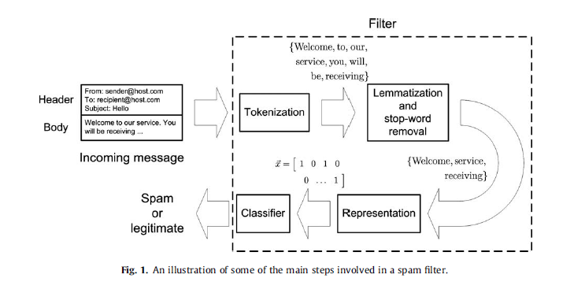
Spam Filtering Review

Slide 26
Lemmatization
AFTER LEMMATIZING
Subject: re : 2 . 882 s - > np np> date : sun , 15 dec 91 02 : 25 : 02 est > from : michael < mmorse @ vm1 . yorku . ca > > subject : re : 2 . 864 queries > > wlodek zadrozny asks if there is " anything interesting " to be said > about the construction " s > np np " . . . second , > and very much related : might we consider the construction to be a form > of what has been discussed on this list of late as reduplication ? the > logical sense of " john mcnamara the name " is tautologous and thus , at > that level , indistinguishable from " well , well now , what have we here ? " . to say that ' john mcnamara the name ' is tautologous is to give support to those who say that a logic-based semantics is irrelevant to natural language . in what sense is it tautologous ? it supplies the value of an attribute followed by the attribute of which it is the value . if in fact the value of the name-attribute for the relevant entity were ' chaim shmendrik ' , ' john mcnamara the name ' would be false . no tautology , this . ( and no reduplication , either . )
Subject: re : 2 . 882 s - > np np> deat : sun , 15 dec 91 2 : 25 : 2 est > from : michael < mmorse @ vm1 . yorku . ca > > subject : re : 2 . 864 query > > wlodek zadrozny ask if there be " anything interest " to be say > about the construction " s > np np " . . . second , > and very much relate : may we consider the construction to be a form > of what have be discuss on this list of late as reduplication ? the > logical sense of " john mcnamara the name " be tautologous and thus , at > that level , indistinguishable from " well , well now , what have we here ? " . to say that ' john mcnamara the name ' be tautologous be to give support to those who say that a logic-base semantics be irrelevant to natural language . in what sense be it tautologous ? it supplies the value of an attribute follow by the attribute of which it be the value . if in fact the value of the name-attribute for the relevant entity be ' chaim shmendrik ' , ' john mcnamara the name ' would be false . no tautology , this . ( and no reduplication , either . )

Slide 27
Stop-Words
AFTER STOP WORDS
Subject: re : 2 . 882 s - > np np> date : sun , 15 dec 91 02 : 25 : 02 est > from : michael < mmorse @ vm1 . yorku . ca > > subject : re : 2 . 864 queries > > wlodek zadrozny asks if there is " anything interesting " to be said > about the construction " s > np np " . . . second , > and very much related : might we consider the construction to be a form > of what has been discussed on this list of late as reduplication ? the > logical sense of " john mcnamara the name " is tautologous and thus , at > that level , indistinguishable from " well , well now , what have we here ? " . to say that ' john mcnamara the name ' is tautologous is to give support to those who say that a logic-based semantics is irrelevant to natural language . in what sense is it tautologous ? it supplies the value of an attribute followed by the attribute of which it is the value . if in fact the value of the name-attribute for the relevant entity were ' chaim shmendrik ' , ' john mcnamara the name ' would be false . no tautology , this . ( and no reduplication , either . )
Subject: re : 2 . 882 s - > np np> date : sun , 15 dec 91 02 : 25 : 02 est > : michael < mmorse @ vm1 . yorku . ca > > subject : re : 2 . 864 queries > > wlodek zadrozny asks is " anything interesting " said > construction " s > np np " . . . second , > much related : might consider construction form > has been discussed list late reduplication ? > logical sense " john mcnamara name " is tautologous thus , > level , indistinguishable " , , here ? " . ' john mcnamara name ' is tautologous is support those logic-based semantics is irrelevant natural language . sense is tautologous ? supplies value attribute followed attribute is value . fact value name-attribute relevant entity were ' chaim shmendrik ' , ' john mcnamara name ' false . tautology , . ( reduplication , either . )

Slide 28
Feature Selection
Feature space of text classification problems can be large
Size of the vocabulary in the worst-case
Increases the computational costs of training a model and performing predictions
Model complexity?
Goal: reduce the size of the feature space by retaining only the top-N features
Example: TF of Top-N terms that help predict whether a message is spam
But how do we select features
Fix an N and try all subsets of N features?

Slide 29
Feature Selection
Yang, Yiming, and Jan O. Pedersen. "A comparative study on feature selection in text categorization." Icml. Vol. 97. 1997.
Features are selected based on statistical or information-theoretic metrics that rank terms in order of discriminative power
Document frequency
Information Gain (IG)
Mutual Information (MI)
χ² Statistic
Term Importance (TI)
Document Frequency: retain only the top-N most frequently occurring term in the training dataset
What about infrequent/rare but highly informative terms?
Common but non-informative terms? Arguably stop-lists are doing the opposite

Slide 30
Information Gain (IG)
IG measures the “number of bits of information the presence or absence of a term reveals about the document category (spam/legit)”
But how do we measure “information”
Entropy: the entropy of a random variable X is
Consider a Bernoulli random variable and assume that
What is H(X)?
Measured in “bits”

Slide 31
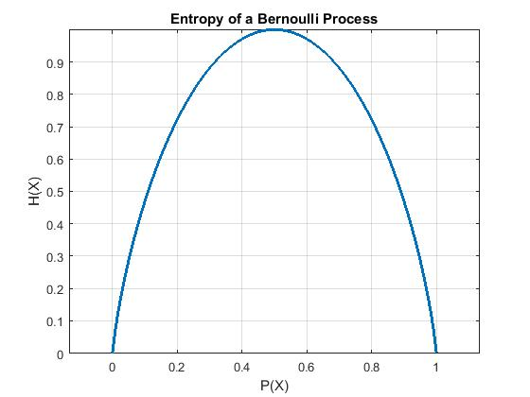
Entropy of Bernoulli RV
Entropy = 0 bits
Outcome of RV reveals no information that you didn’t already have!
Entropy = 1 bit
Each trial reveals one full bit of information

Slide 32
Back to Information Gain
Let C be a RV that determines if a document is spam or legit
H(C) is the inherent uncertainty in the RV
Let X_{i} be a RV that represents the occurrence of frequency of term i
Can be either binary or TF
How much information does X_{i} provide about C
IG measures the reduction in entropy of C if X_{i} is known
Inherent uncertainty
Uncertainty given X_{i}

Slide 33
Conditional Entropy
Assuming binary features:

Slide 34
In-Class Exercise
# Spam Emails in Training Dataset: 50
# Legit Emails in Training Dataset: 100
Word/Term | #Spam Emails with Term | #Legit Emails with Term
“FREE” | 40 | 0
“George” | 0 | 20
“and” | 40 | 80
Compute the IG of “Free”, “George” and “and”

Slide 35
χ² Test Statistic
χ² test is a commonly used statistical test to measure the independence between two random variables
If there are only two classes then so we use
A: Number of instances in which document class c and X_{i} co-occur
B: Number of instance in which term X_{i} occurs in other document classes
C: Number of documents of class c that don’t have term X_{i}
D: Number of instances of other “non-c” document classes that don’t have term X_{i}

Slide 36
In-Class Exercise
# Spam Emails in Training Dataset: 50
# Legit Emails in Training Dataset: 100
Word/Term | #Spam Emails with Term | #Legit Emails with Term
“FREE” | 40 | 0
“George” | 0 | 20
“and” | 40 | 80
Compute the χ² statistic of “Free”, “George” and “and”

Slide 37
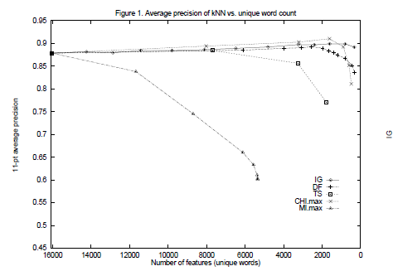
Empirical Results
Maximum precision achieved by χ²
IG performs best with very few features
DF has least precision but still competitive, especially as number of features increases
Performance on Reuters dataset with kNN classfier

Slide 38
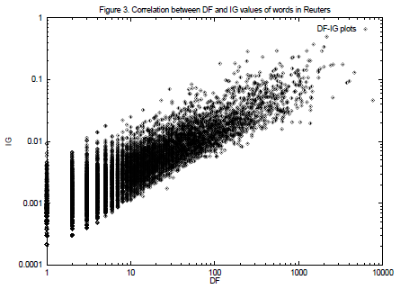
DF Vs. IG
Terms that DF might miss
Performance on Reuters dataset with kNN classfier

Slide 39
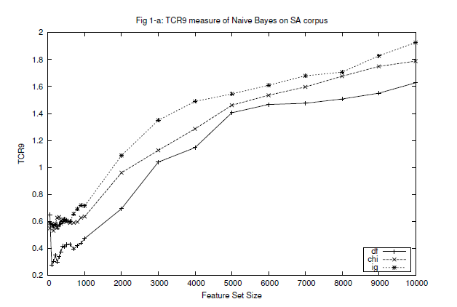

Results on Spam Dataset
Zhang, Le, Jingbo Zhu, and Tianshun Yao. "An evaluation of statistical spam filtering techniques." ACM Transactions on Asian Language Information Processing (TALIP) 3.4 (2004): 243-269.

Slide 40
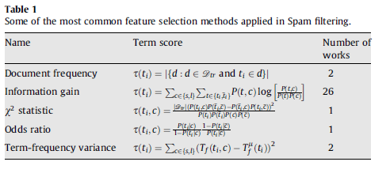
So What’s Used in Literature

Slide 41
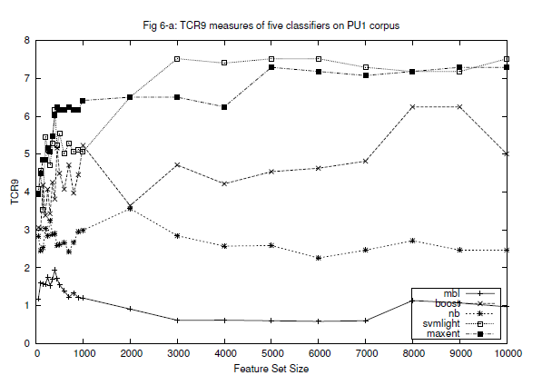
Other Approaches to Spam Filtering
SVM
MaxENT
Boosting
NB

Slide 42
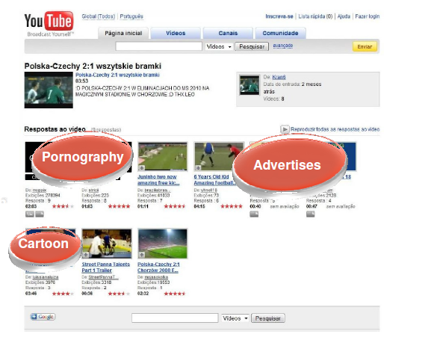
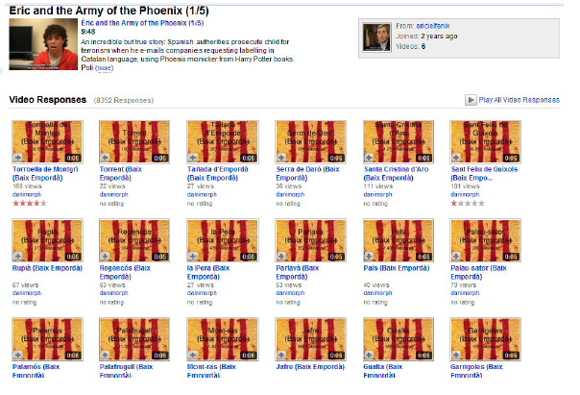
Spam Detection on Social Media
Benevenuto, Fabrício, et al. "Detecting spammers and content promoters in online video social networks." Proceedings of the 32nd international ACM SIGIR conference on Research and development in information retrieval. ACM, 2009.
Spammers try to poison search results in order to get more views for unrelated videos
Promoters post unrelated videos to increase the relevance of certain topics

Slide 43
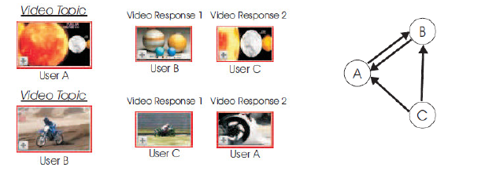
What are the Right Set of Features
Since we’re looking at social networks, it might be meaningful to exploit social network structure
How do we capture the structure of a graph as a number?

Slide 44
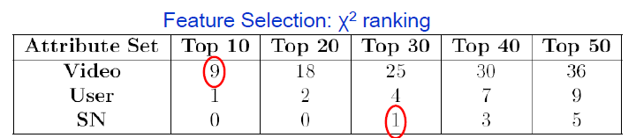
Features/Attributes Used
Social Network features
Clustering coefficient, “betweenness”, UserRank etc. (more on this later)
User-based
Number of friends, number of subscriptions, number of subscribers
Video-based
Duration, number of views, number of comments received, ratings

Slide 45
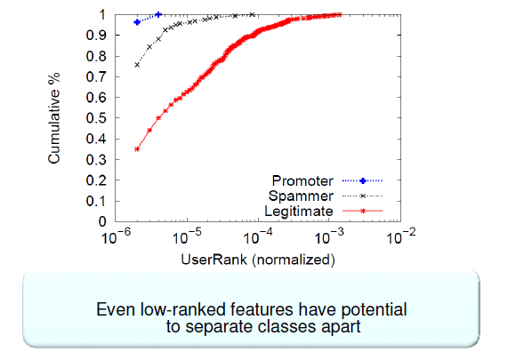
UserRank as a Feature

Slide 46
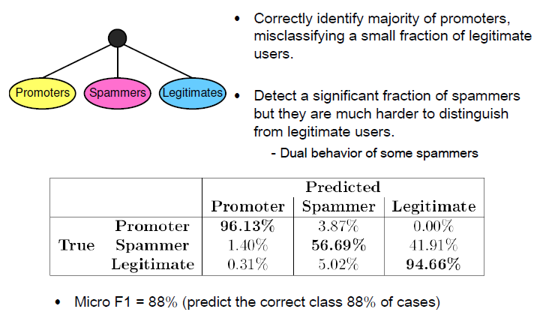
Classification Results Using SVMs

